Slide 1
Digital Portfolio
STUDENT NAME:Manoj
REGISTER NO AND NMID: 24132251802521031
DEPARTMENT: BSC computer science COLLEGE: COLLEGE/ Government arts and science college
UNIVERSITY Annamalai University

Slide 2
PROJECT TITLE
(Give a clear, concise, and creative title for your project)
Smart Attendance System Using Face Recognition

Slide 3


AGENDA
Problem Statement
Project Overview
End Users
Tools and Technologies
Portfolio design and Layout
Features and Functionality
Results and Screenshots
Conclusion
Github Link
3/21/2024 Annual Review

Slide 4

PROBLEM STATEMENT
Explain the issue or challenge your project aims to solve.)
Traditional attendance systems are time-consuming. pronc to human error, and can be manipulated There is a need for an automated, secure. student attendance. ient system to record

Slide 5

PROJECT OVERVIEW
(Brief description of the project its goals, and what it does.) Example This project develops a face recognition-based attendance system that automatically detects and marks attendance. ft reduces manual effort. ensures accuracy, and saves time.

Slide 6

WHO ARE THE END USERS?
(Mention who will use the project or benefit from it) Students Teachers School/College Administration

Slide 7

TOOLS AND TECHNIQUES
(List the software, hardware, and methodologies used.) Programming Language: Python Libraries: OpenCV. NumPy Database: MySQL Tools: Jupyter Noteboo Studio Code

Slide 8
POTFOLIO DESIGN AND LAYOUT
(Describe the design of your digital portfolio.) Homepage: Introduction, project title, and student details Project Section: Problem statement overview. Tools. screenshots Features Page: Key functionality explained Results Page: Outcomes and screenshots Conclusion Page: Summary and learnings. Clean and minimal layout with images, icons, and diagrams
8

Slide 9
FEATURES AND FUNCTIONALITY
(Highlight the core functions of the project.) Automatic face detection and recognition Real-time attendance marking. Database storage of records Admin login and dashboard Attendance reports generation

Slide 10
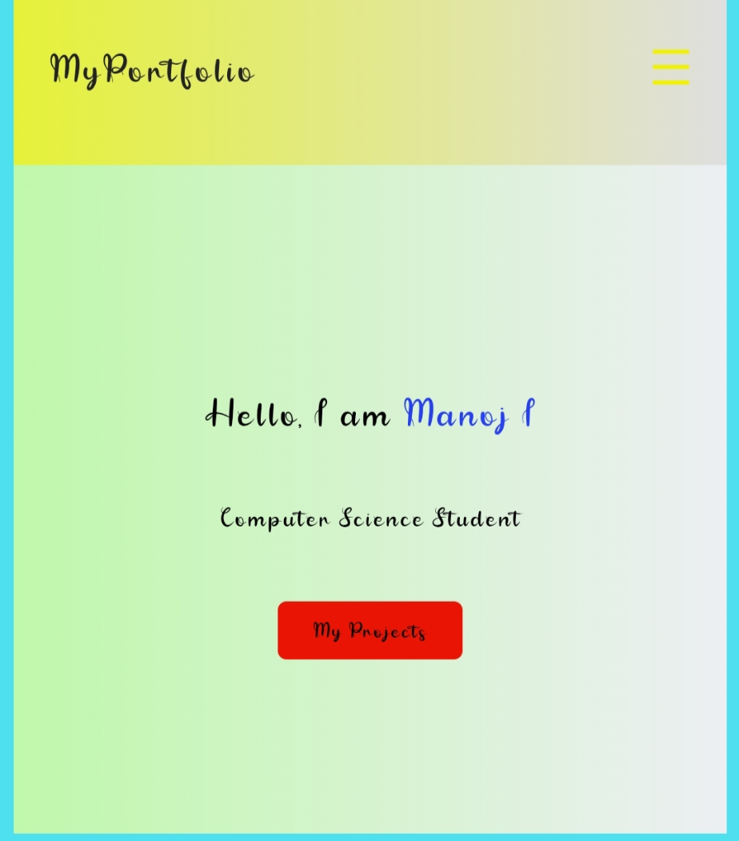

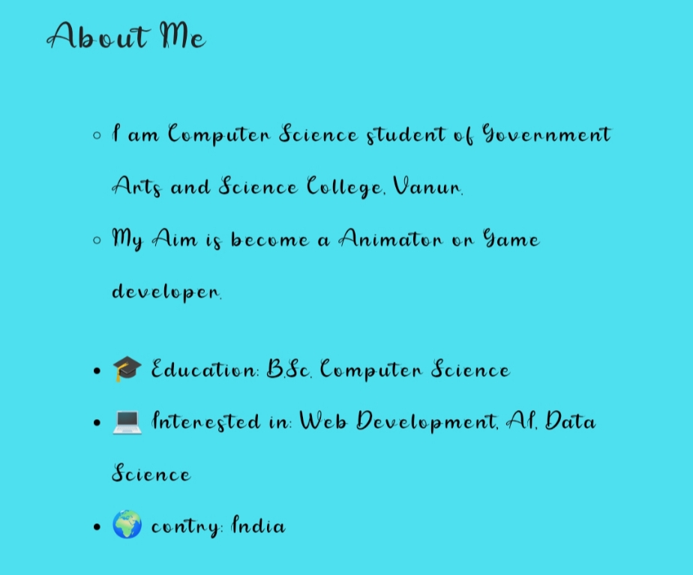
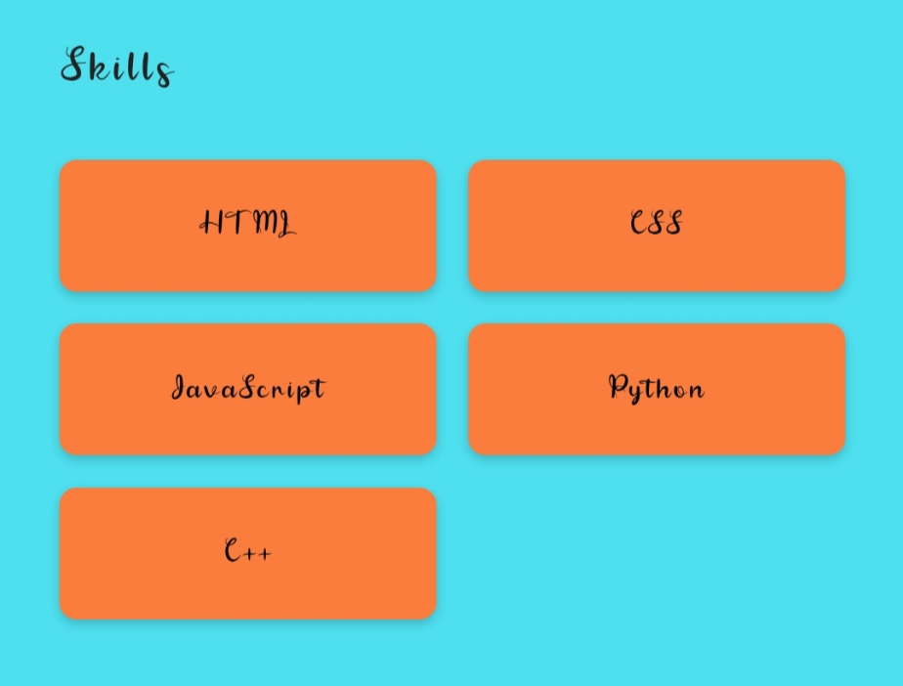
RESULTS AND SCREENSHOTS
3/21/2024 Annual Review
10

Slide 11
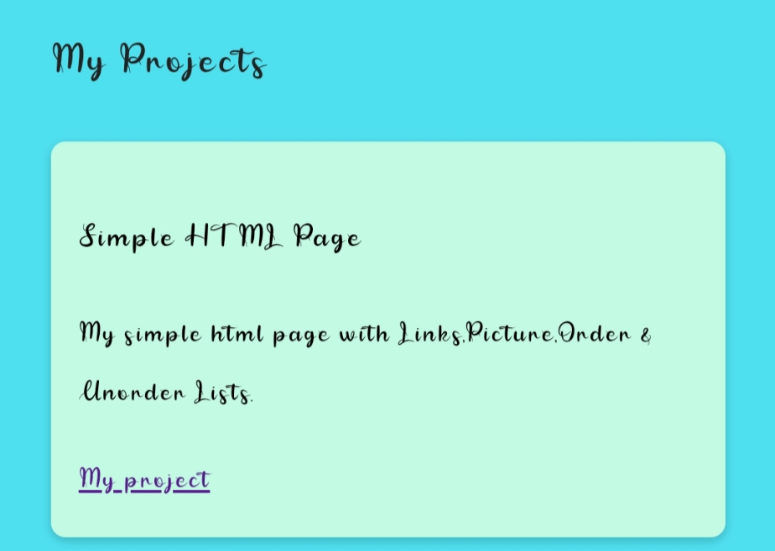
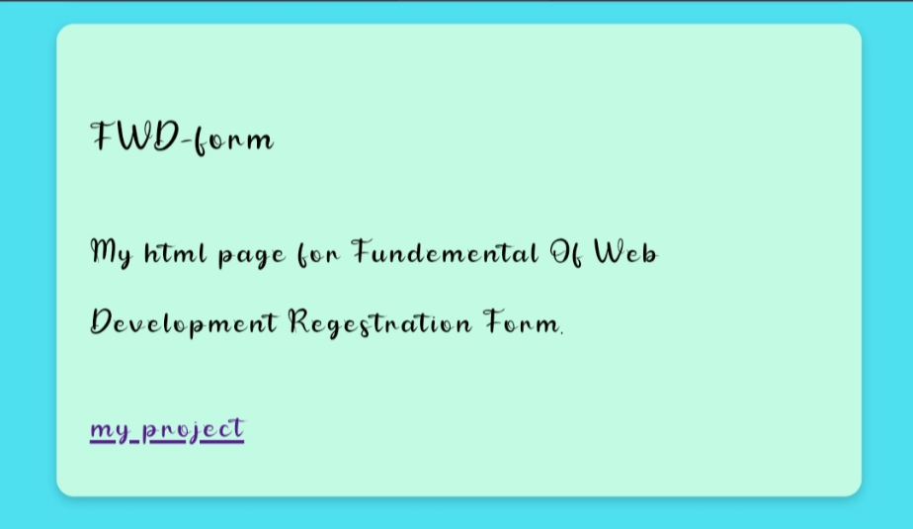

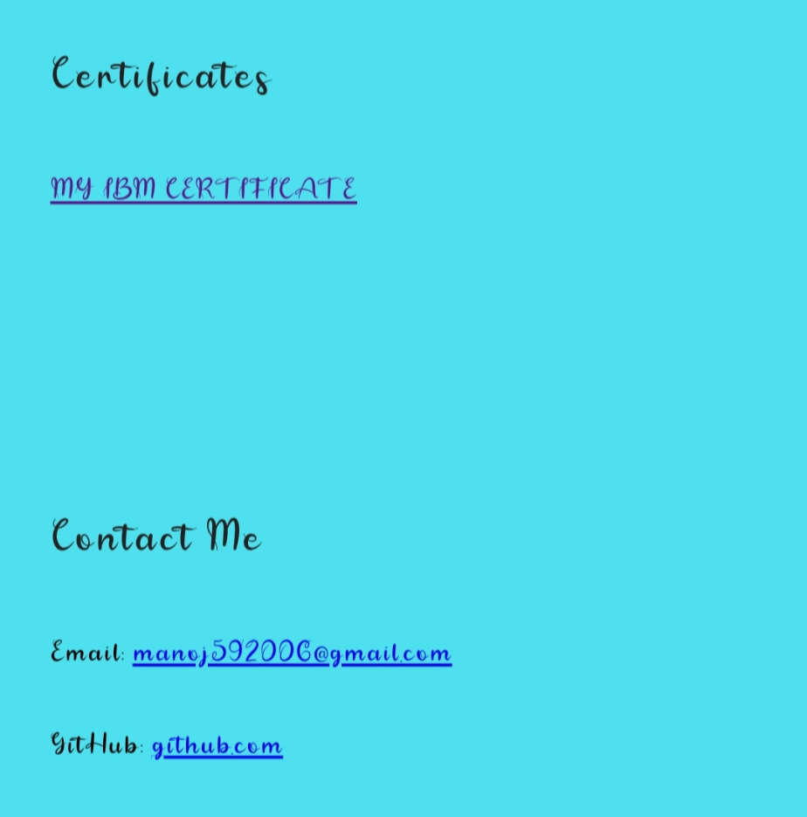

Slide 12
CONCLUSION
(Summarize what you learned, achieved, and possible future improvements.) Example: The project successfully automated the attendance system using face recognition, improving accuracy and efficiency. Future improvements may include integrating the system with mobile apps and cloud-based databases for broader accessibility.
12

